Slide 1
GlobalWafers (6488TT)
Q1 2024 Earnings Call
2024/05/07

Slide 2
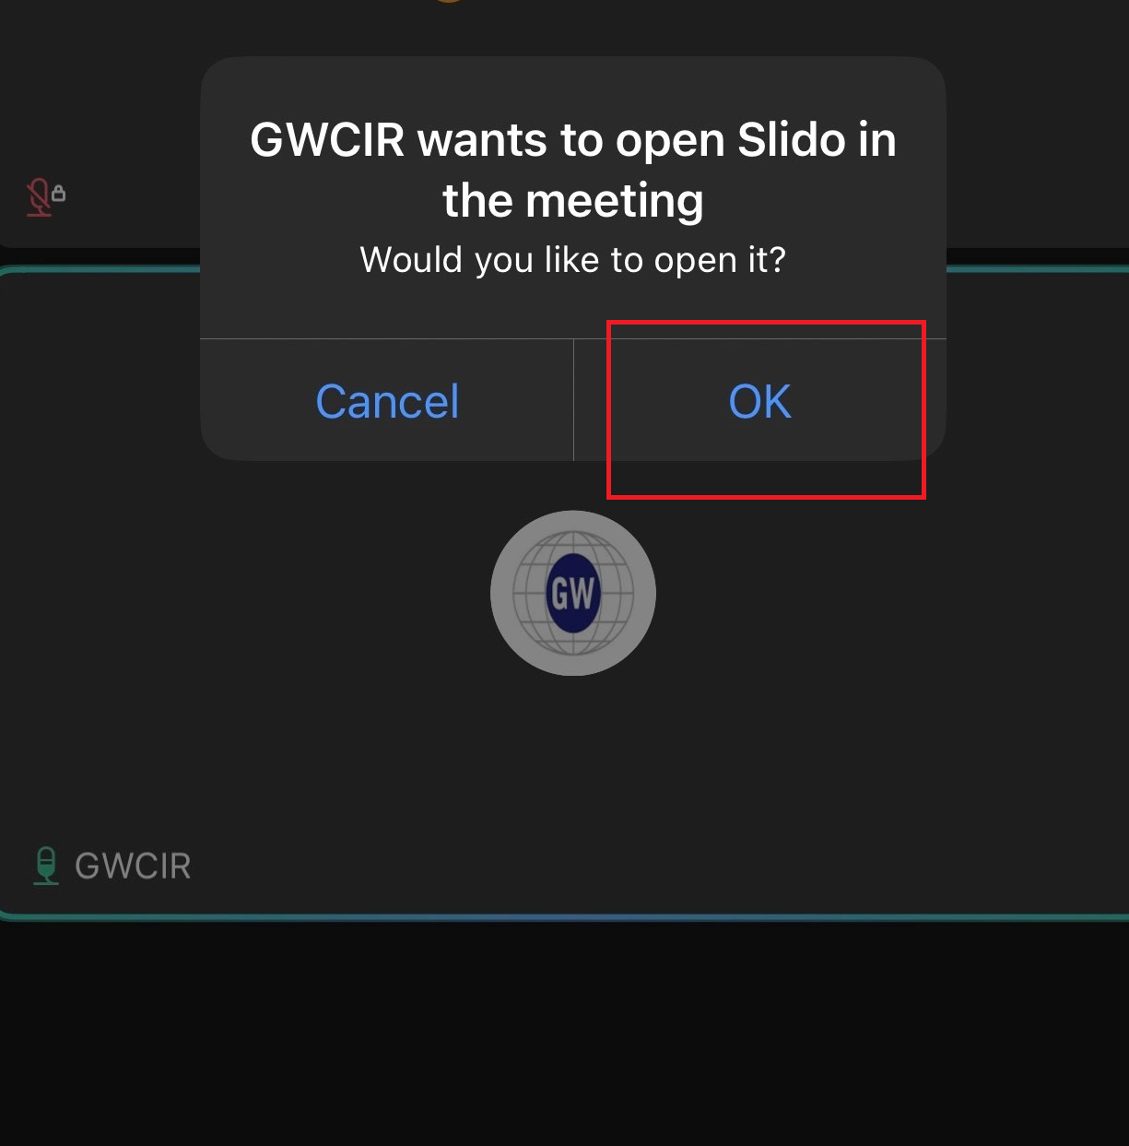
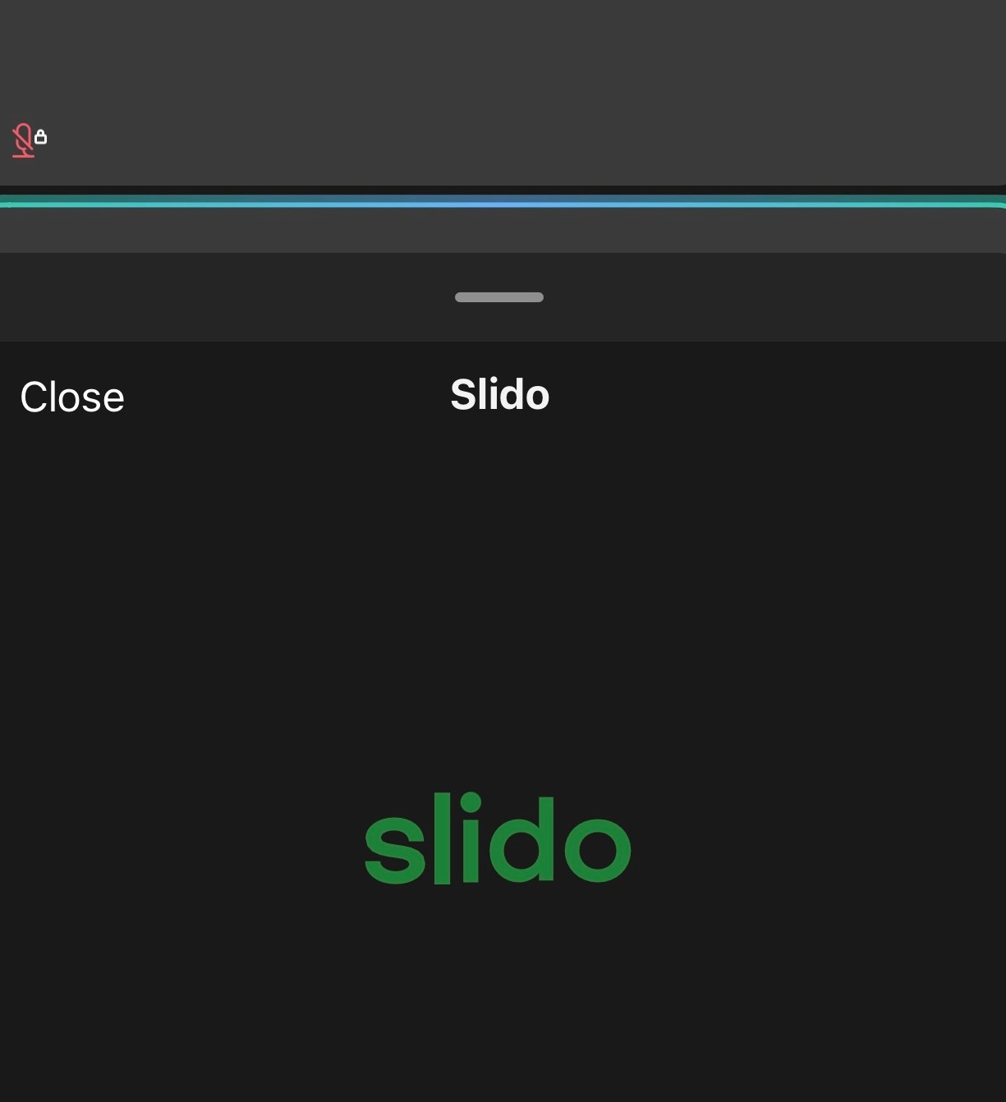
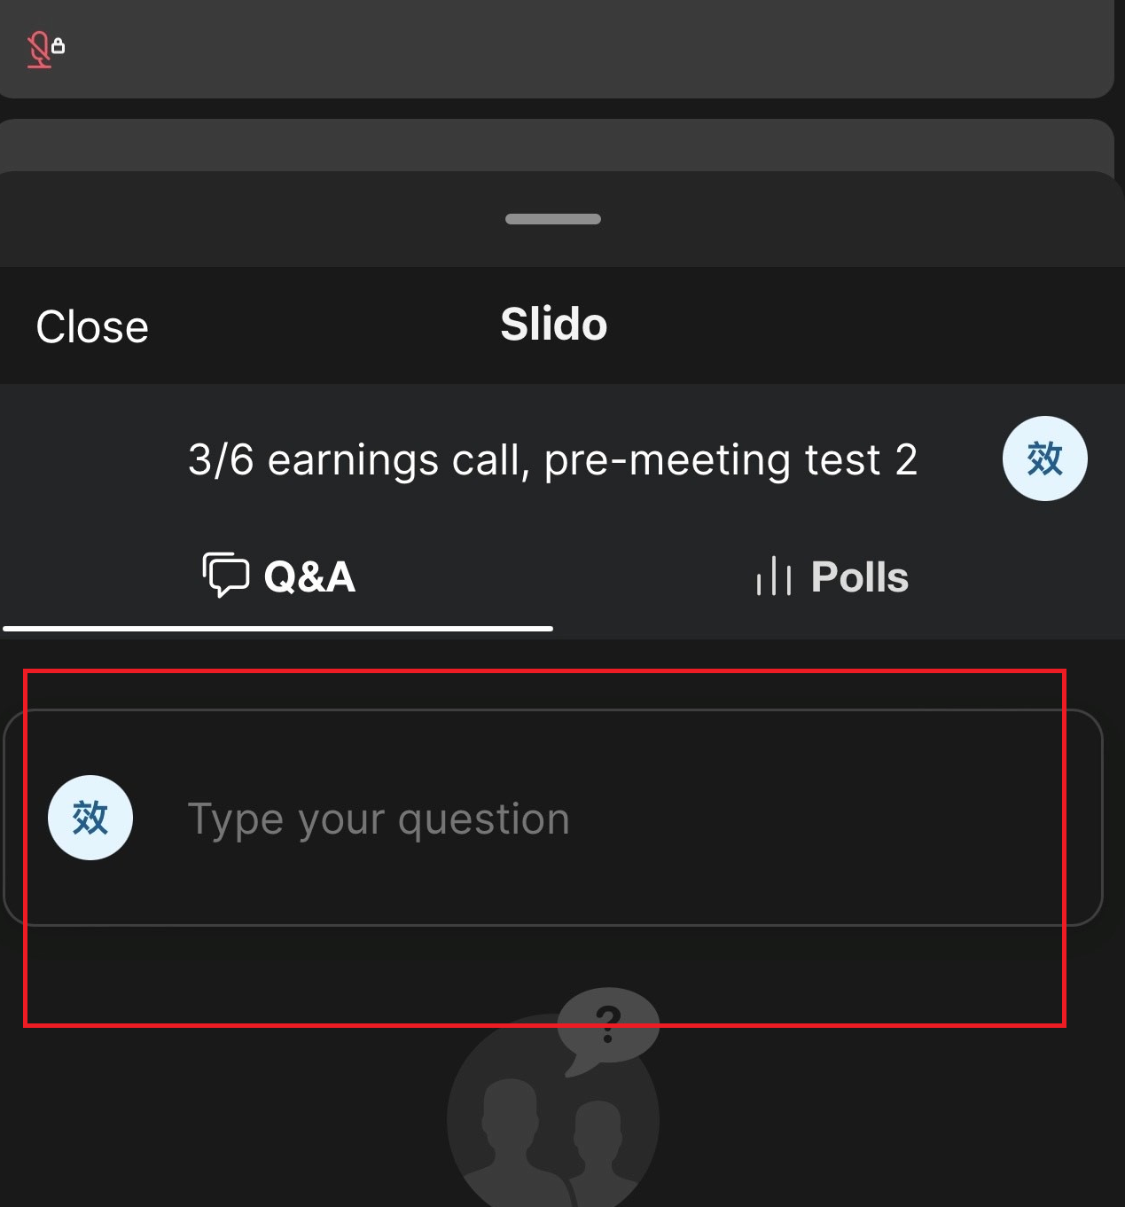
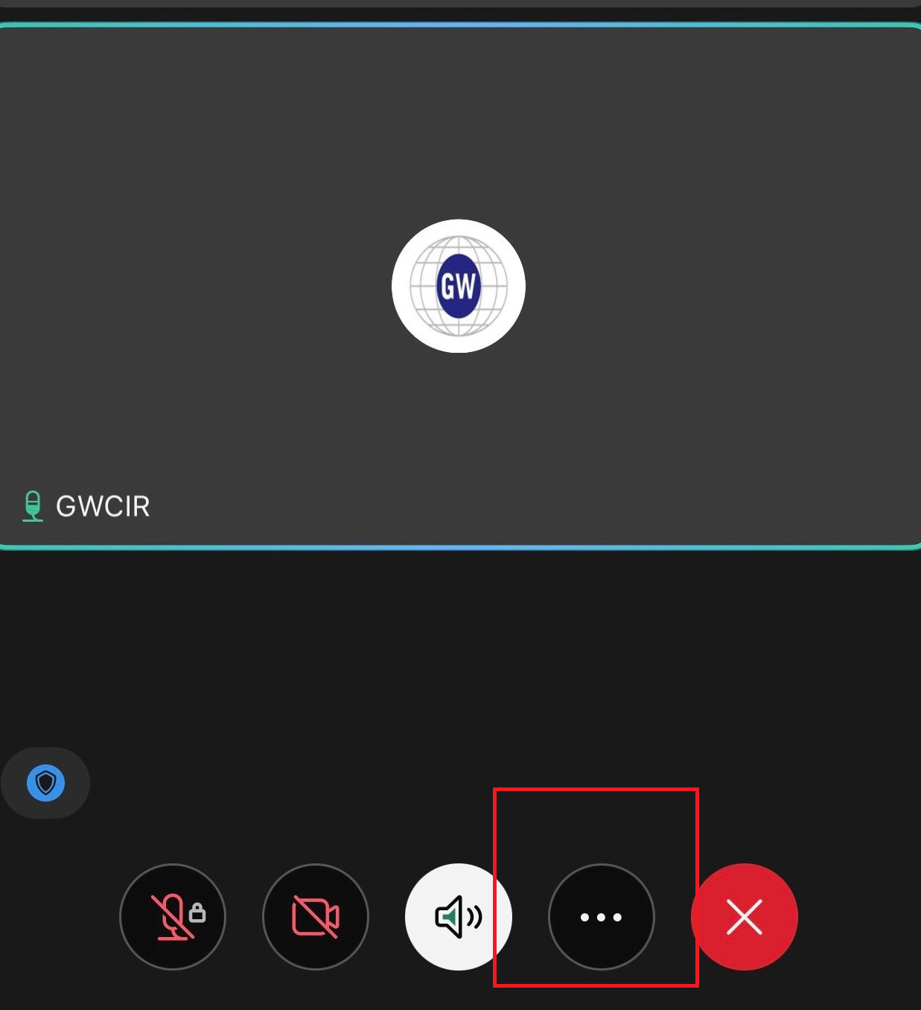
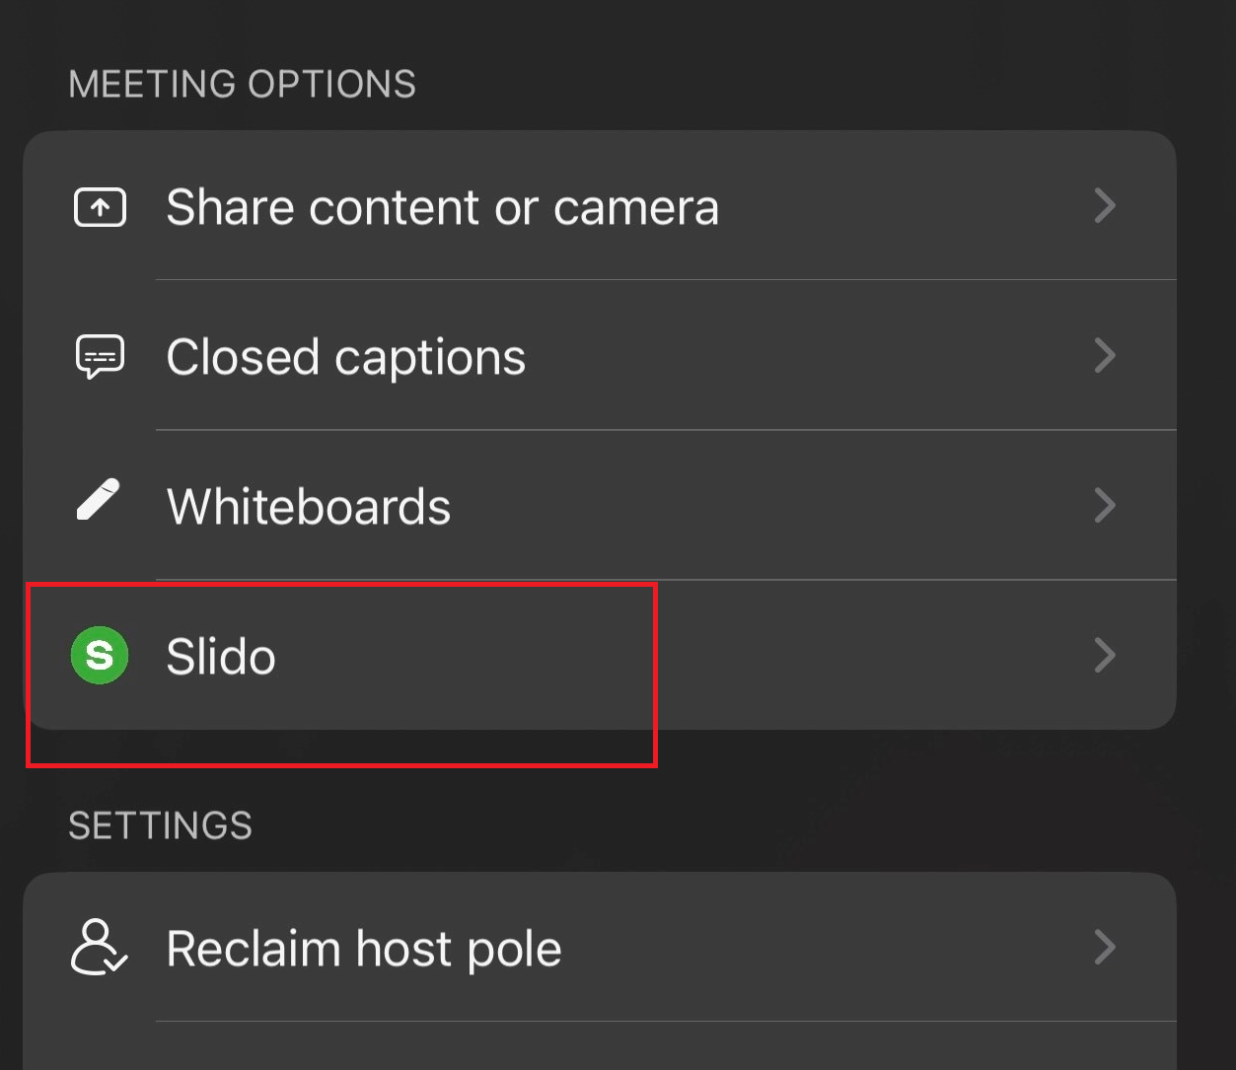
Q&A via Slido
Step1 Step2 Step3
2. A Slido interface will be presented.
1. Click OK upon seeing “GWCIR wants
to open Slido in the meeting”.
3. Input your questions.
If you exit Slido and wish to re-enter the platform:
Please note：
1. Inputting questions in English is suggested.
2. Sending all questions in one go is suggested.
3. Questions will be taken during the Q&A session.

Slide 3
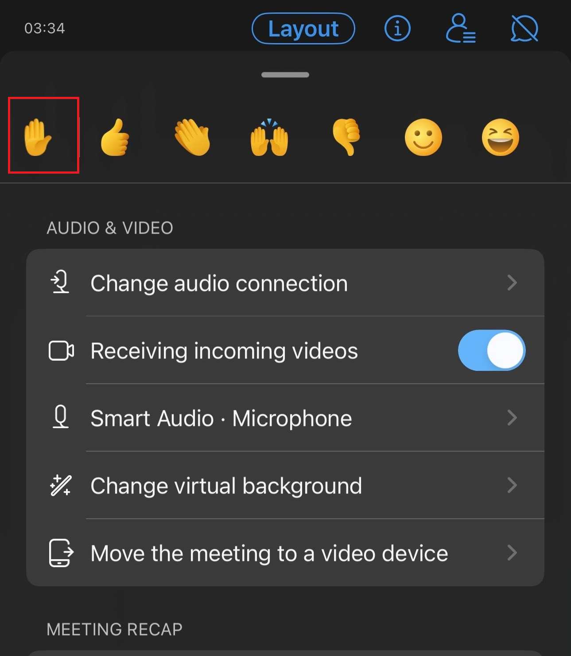
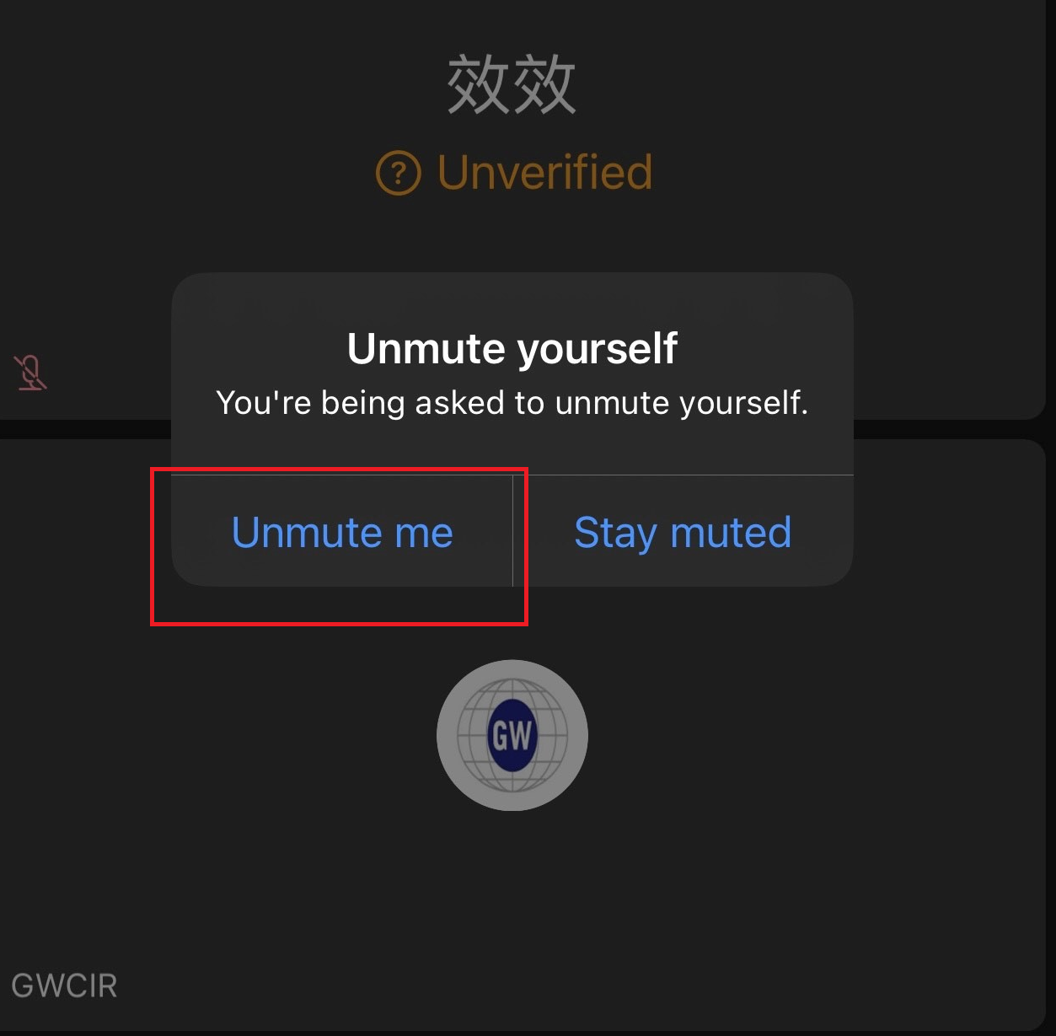
Q&A via Audio
Step1 Step2 Step3
Click on the icon with three dots on the lower right.
Click “Raise your hand" on the upper left.
Unmute yourself to ask questions upon receiving our invitation.
Please note：
Questions will be taken during the Q&A session.

Slide 4
Disclaimer
This presentation has been prepared by GlobalWafers Co., Ltd. (the “Company”). This presentation and the materials provided herewith do not constitute an offer to sell or issue or the solicitation of an offer to buy or acquire securities of the Company in any jurisdiction or an inducement to enter into investment activity, nor may it or any part of it form the basis of or be relied on in connection with any contract or commitment whatsoever. Any decision to purchase securities in a proposed offering should be made solely on the basis of the information contained in the offering circular published in relation to such proposed offering, if any.
The information contained in this presentation has not been independently verified. No representation, warranty or undertaking, express or implied, is made as to, and no reliance should be placed on, the fairness, accuracy, completeness or correctness of the information or the opinions contained herein. The information contained in this document should be considered in the context of the circumstances prevailing at the time and has not been, and will not be, updated to reflect material developments which may occur after the date of the presentation. None of the Company nor any of its affiliates, advisors or representatives will be liable (in negligence or otherwise) for any loss howsoever arising from any use of this presentation or its contents or otherwise arising in connection with the presentation.

Slide 5
01
Executive Comment

Slide 6
Executive Comments
Financial Highlights
Revenue
Q124 → NT$15 billion, -19% YoY
Despite the economic downturn, 2024 marks continuous monthly growth for two consecutive months since January !
Gross Profit (%)
Q124 → 34.3%
Operating Income (%)
Q124 → 26.3%
2024 (NT$ mn) | Jan | MoM | Feb | MoM | Mar
Revenue | 4,396 | 14.40% | 5,029 | 12.59% | 5,662

Slide 7
Financial Highlights
Net Profit (%)
Q124 → 23.4%
EPS
Q124 → NT$8.10
Prepayment
NT$35.03 billion (US$1.1 billion)¹
Planned Dividend Payout
2023 Dividend – NT$19.0 (1H23: NT$8.0 + 2H23: NT$11.0)
2023 Payout Ratio – 41.8%
Record Date – July 24, 2024
Payment Date – August 16, 2024
Note:
FX Rate: NTD:USD = 32.000, including guarantee

Slide 8
Industry & Overview
Global Economy
The IMF projects a consistent 3.2% growth rate for the global economy throughout 2024 and 2025, consistent with the same growth rate in 2023, highlighting the resilience of the global economy.
Reflecting improving consumer confidence and a rising trend in global GDP, the global PMI¹ continues to rise, signaling a broad-based upturn, notwithstanding the looming inflationary risks.
Semiconductor Industry
With demand improving due to the growth of AI applications and memory devices emerging as the largest contributors, inventory levels are expected to gradually normalize as customers reabsorb on-hand stock, alongside moderate improvements in fab utilization rates. The second half of 2024 is expected to see recovery compared to the first half, however there are ongoing uncertainties like the pace of interest rate cuts, oil prices, and electric vehicle demand.
GlobalWafers is well-positioned to allocate its Capex towards the current market trend in the semiconductor industry in response to the increasing demand for advanced semiconductor processes.
Source:
IMF, April 2024
OECD, March 2024
Note:
PMI = Purchasing Managers’ Index

Slide 9
Sustainable Solutions
GlobalWafers has differentiated itself through proximity and sustainability by leveraging its global presence to reduce carbon footprint and adopts green energy initiatives from each region to counteract climate change and provide customers with sustainable solutions. This commitment is exemplified by the introduction of green energy in expansion projects :
Danish site – 1st semiconductor crystal manufacturing site to utilize its own installed 100% green electricity during 2H of 2024
Italian site – 100% green electricity in new 12” production line during the 2025 ramp-up
USA site – 100% renewable energy at full ramp
By sourcing locally, GlobalWafers minimizes transportation, leading to reduced carbon emissions, lower geopolitical risks, and greater environmental sustainability.
Earthquake Impact
Despite the April-3 earthquake in Taiwan affecting some pullers, operations have resumed after inspection with minimal impact on revenue, facilitated by ample ingot inventory prepared in advance for unforeseen events, ensuring smooth production transition and supply continuity for subsequent sites.

Slide 10
Others
Corporate Governance Evaluation
For the tenth (2023) Corporate Governance Evaluation, GlobalWafers has been ranked among the top 5% of all TPEx-listed companies for the sixth consecutive year, reflecting its commitment to "responsible growth" through continuous improvements in corporate governance and sustainability to enhance competitiveness.

Slide 11
02
Industry Overview

Slide 12
Sustainable Solutions
GlobalWafers responds to the challenges of global climate risks by dedicating to environmental sustainability in its manufacturing processes, renewable energy adoption and business strategies.
Sustainable Solutions
Renewable Energy Usage Commitment
GlobalWafers‘ Danish site, Topsil GlobalWafers A/S, is positioned to become the first semiconductor crystal manufacturing site to utilize its own installed 100% green electricity by the second half of 2024.
Denmark
(Topsil)
Renewable Energy Usage Commitment
GlobalWafers' Italian site, MEMC Electronic Materials S.p.A., is also anticipated to achieve 100% green electricity usage in the 12” new line during the capacity ramp-up stage in 2025.
Italy
(S.p.A.)
Renewable Energy Usage & Water Recycle Commitments
GlobalWafers’ flagship 300mm greenfield expansion, GlobalWafers America LLC, will recycle more than half of its water used in production and plan to utilize 100% renewable energy at full ramp-up to manufacture the world’s most advanced silicon wafers.
USA
(GWA)

Slide 13
12” Fab Equipment Investment
Worldwide 12” fab equipment investment is expected to increase 20% to US$116.5 billion in 2025 and 12% to US$130.5 billion in 2026 before hitting a record high in 2027 according to the research.
The foundry segment is leading in growth to meet demand for generative AI, automotive, and intelligent edge devices, while the memory segment ranks second, with increased investment in 300mm fab equipment over the coming years indicating the capacity needed to meet demand driven by new AI applications.
12” Fab Equipment Spending Forecast
GlobalWafers allocates its entire Capex to advanced processes
(USD Bn)
Record High !
Large-Size Wafers
- 12” PW - 12” EPI
137
Special Wafers
- 8” FZ - 12” SOI
Compound Semiconductors
- SiC - SiC EPI
- GaN on Si
Source: SEMI, March 2024

Slide 14
Semiconductor Production Capacity Build-Up
GlobalWafers’ expansions in Asia, the US, and Europe well align with the semiconductor device manufacturers in various regions as they increase capacity.
GlobalWafers Capacity Expansion Regions
Semiconductor Manufacturing Capacity Build-up
Capacity in 300mm (kwpy), across node sizes, non-memory
Asia
US
(Share of total build up)
2023-2027
Capacity Build-up (kwpy) +25.8%
Cheonan, South Korea
St. Peters, MO
Hsinchu, Taiwan (x2)
Sherman, TX (x2)
Europe
Niigata, Japan
Utsunomiya, Japan
Copenhagen, Denmark
Novara, Italy
Source: McKinsey & Company, April 2024

Slide 15
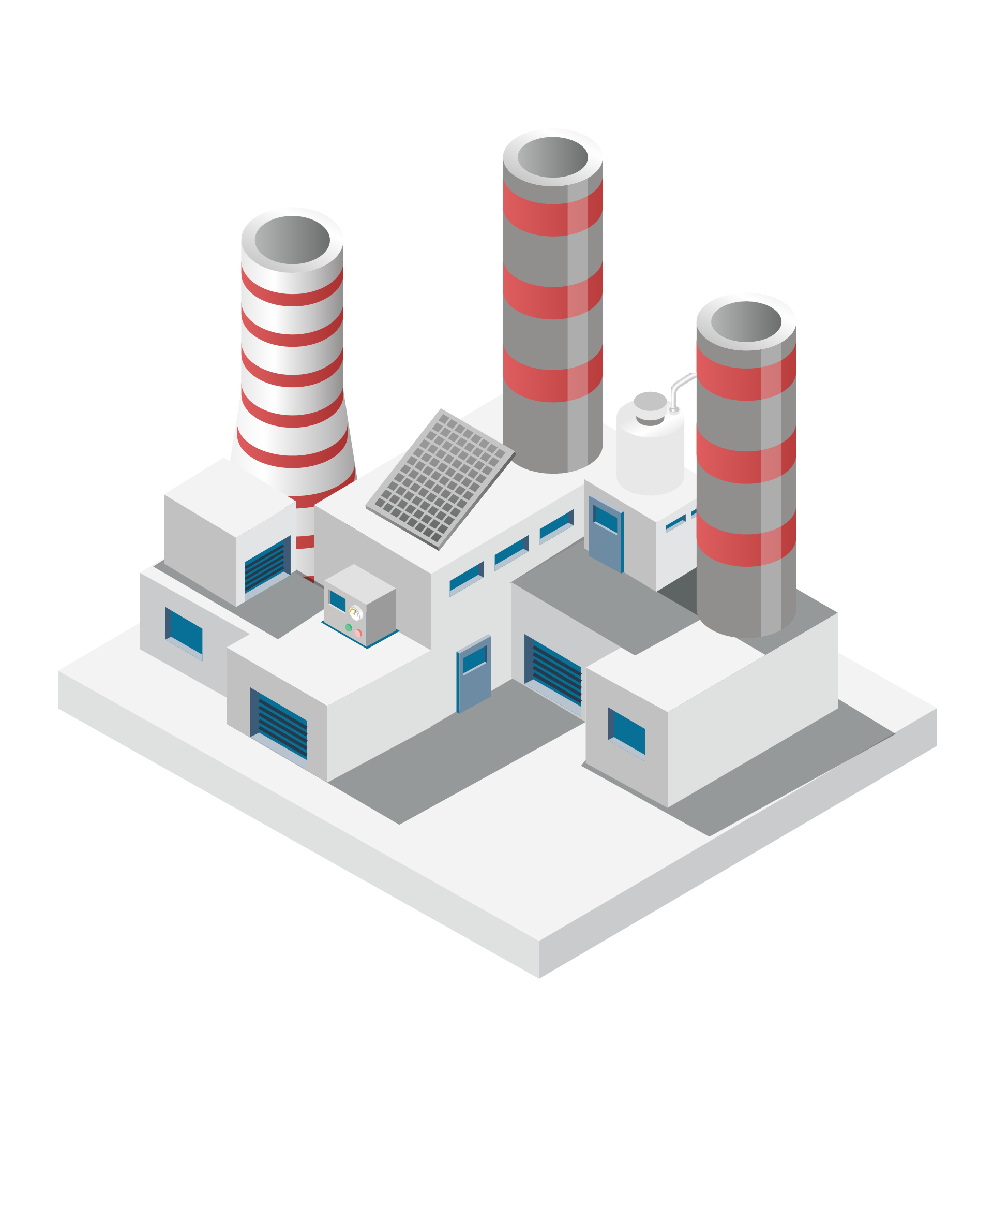
GlobalWafers America (GWA): 300mm Greenfield Expansion
GlobalWafers' flagship 300-mm factory, GWA¹, is on schedule and has submitted a full application for the CHIPS Act and is now in discussions with the CHIPS Program Office (CPO) at the Department of Commerce to determine a targeted grant amount.
GWA Timeline
The only advanced node wafer manufacturer in the United States
GWA is expected to become the only source of 12’’ fab in the advanced US-manufactured semiconductor wafer
Plan to utilize 100% renewable energy at full ramp-up
Q422
Q424
The largest wafer fab in the USA and among the largest in the world
Q324
Q125
The construction team has completed 1.2 million work hours with zero lost-time accidents, making the GWA project one of the safest large-scale commercial projects in the U.S
Groundbreaking
First Equipment Install
Construction Complete/Qual Sample Shipment
High Volume Manufacturing Begins
Notes:
Refers to GlobalWafers America, our greenfield fab in Sherman, Texas

Slide 16
Low Funding Cost Supporting Future Capex
GlobalWafers ensures low-interest funding for its Capex through channels like CB¹, ECB², Exchangeable Unit, and GDSs³, safeguarding the company from interest rate fluctuations and fostering long-term growth.
GWC Funding Source
Amount | Interest Rate | Maturity
NT$ 6.5 bn | 0.62% | 2026
NT$ 12.5 bn | 0.5% / 0.6% | 2024 / 2026
US$ 1 bn | -0.25% | 2026
EUR$ 345.2 mn | 1.50% | 2029
NT$ 50 bn | 1.7% / 1.75% | 2029 / 2031
US$ 688.8 mn | - | -
GDSs Issuance Assumption on Financial Ratios⁵
Corporate Bond #1
Corporate Bond #2
Euro Convertible Bond
Exchangeable Unit
Corporate Bond #3
GDSs
GWC raised over US$1 billion in low-interest funding in Q124⁴ to support the company's sustainable growth
> US$1bn
Undrawn Loan Commitment* Rate
GlobalWafers is strategically positioned with abundant undrawn loan commitments, providing sufficient funds for upcoming Capex needs in the coming years.
75%
(As of 2024.3)
*Committed Loan: Including bank guarantee.
Note:
CB = Corporate Bond
ECB = Euro Convertible Bond
GDSs = Global Depository Shares
GWC raised funding in Q124, which includes Exchangeable Units, Corporate Bond #3, and GDSs
GDSs proceeds are received in April 2024, simulating if the proceeds were received in Q124.
15

Slide 17
03
Financial Performance

Slide 18
Financial Highlight : Q124 vs. Q423 vs. Q123
(NT$ mn) | Q124 | Q423 | Q123 | QoQ | YoY
Revenue | 15,087 | 16,763 | 18,616 | -10.0% | -19.0%
Gross Profit % | 34.3% | 34.5% | 40.6% | -0.2 ppt | -6.3 ppts
Operating Income | 3,968 | 3,921 | 6,103 | 1.2% | -35.0%
Operating Income % | 26.3% | 23.4% | 32.8% | 2.9 ppts | -6.5 ppts
Net Profit | 3,533 | 4,442 | 5,000 | -20.5% | -29.3%
Net Profit % | 23.4% | 26.5% | 26.9% | -3.1 ppts | -3.5 ppts
EPS¹ | NT$8.10 | NT$10.19 | NT$11.49 | -NT$2.09 | -NT$3.39
EBITDA*² | 5,882 | 6,808 | 7,907 | -13.6% | -25.6%
EBITDA % | 39.0% | 40.6% | 42.5% | -1.6 ppts | -3.5 ppts
EBIT³ | 4,025 | 5,028 | 6,302 | -19.9% | -36.1%
ROE*⁴ _{(annualized)} | 20.5% | 26.8% | 35.6% | -6.3 ppts | -15.1 ppts
ROA*⁵_{(annualized)} | 7.5% | 9.8% | 11.8% | -2.3 ppts | -4.3 ppts
Capex⁶ | 10,438 | 12,573 | 5,116 | - | -
Depreciation | 1,852 | 1,774 | 1,601 | - | -
EPS = Net Profit Attributable To The Shareholders of The Company / Weighted-average Number of Ordinary Shares Outstanding During The Period
EBITDA = Net Profit + Tax + Interests + Depreciation + Amortization
EBIT : Net Profit + Tax + interests
ROE = Net Profit / Average Shareholders Equity
ROA = (Net Profit + Interest*(1- Effective Tax Rate))/Average Asset
Capex = Ending Property, Plant & Equipment - Beginning Property, Plant & Equipment + Depreciation

Slide 19
Revenue & Gross Profit (%)
Revenue & Gross Profit (%)
(NT$ mn)
Q124 Gross Profit decreased: Mainly due to the increase of depreciation and power cost

Slide 20
EBITDA & EPS
EBITDA
EPS
(NT$ Mn)
(NT$)
EBITDA
EBITDA to Revenue

Slide 21
Income Statement
Income Statement
(NT$ Mn) |  |  | 2020 | 2021 | 2022 | 2023 | Q124
Revenue |  |  | 55,359 | 61,131 | 70,287 | 70,651 | 15,087
 | Growth (%) |  | -4.7% | 10.4% | 15.0% | 0.5% | -10.0%²
Gross Profit |  |  | 20,568 | 23,286 | 30,342 | 26,441 | 5,168
 | Gross Profit (%) |  | 37.2% | 38.1% | 43.2% | 37.4% | 34.3%³
EBITDA |  |  | 21,967 | 22,507 | 25,526¹ | 30,630¹ | 5,882¹
 | EBITDA (%) |  | 39.7% | 36.8% | 36.3% | 43.4% | 39.0%
Operating Income |  |  | 15,287 | 17,693 | 24,983 | 20,059 | 3,968
 | Operating Income (%) |  | 27.6% | 28.9% | 35.5% | 28.4% | 26.3%
Profit before Tax |  |  | 16,615 | 16,445 | 20,107¹ | 26,496¹ | 4,558¹
 | Profit before Tax Margin (%) |  | 30.0% | 26.9% | 28.6% | 37.5% | 30.2%
Net Profit |  |  | 13,104 | 11,870 | 15,367¹ | 19,770¹ | 3,533¹
 | Net Profit (%) |  | 23.7% | 19.4% | 21.9% | 28.0% | 23.4%
EPS (NT$) |  |  | 30.11 | 27.27 | 35.31¹ | 45.41 | 8.10
Due to the valuation of realized gains/loss on Siltronic shares measured at fair value through profit or loss and impacts from other factors
QoQ growth compared to Q423
Q124 Gross Profit decreased: Mainly due to the increase of depreciation and power costs

Slide 22
Balance Sheet
Balance Sheet
(NT$ Mn) |  |  |  |  |  | 2020 | 2021 | 2022 | 2023 | Q124
Assets
 | Cash and cash equivalents |  |  |  |  | 22,439 | 65,894 | 83,458 | 26,165 | 35,672¹
 | Account receivable |  |  |  |  | 8,037 | 9,118 | 10,160 | 10,116 | 10,061
 | Inventories |  |  |  |  | 7,208 | 7,295 | 8,535 | 9,359 | 10,737²
 | Property, plant and equipment |  |  |  |  | 37,111 | 33,943 | 39,487 | 72,251 | 82,399³
 | Other assets |  |  |  |  | 20,056 | 34,395 | 30,823 | 71,097 | 63,914
Total assets |  |  |  |  |  | 94,852 | 150,645 | 169,496 | 188,988 | 202,783
Liabilities
 | Short-term loan |  |  |  |  | 9,871 | 6,264 | 6,544 | 40,000 | 36,630⁴
 | Account payable |  |  |  |  | 3,895 | 4,340 | 4,176 | 5,027 | 5,189
 | Long-term loan |  |  |  |  | - | 45,125 | 42,780 | 14,542 | 29,007⁵
 | Other liabilities |  |  |  |  | 36,930 | 49,284 | 61,672 | 62,966 | 60,436
Total liabilities |  |  |  |  |  | 50,697 | 105,013 | 115,172 | 122,534 | 131,262⁶
 |  |  |  |  |  |  |  |  |  | -
Shareholder equity |  |  |  |  |  | 44,155 | 45,632 | 54,324 | 66,454⁷ | 71,521⁷
Cash-related other assets include:
(NT$ Mn) | Q124
Deposits in banks held for three months or more | 23,665
Restricted cash 11,259 | 2,908
Q124 Cash and cash equivalents increased: Mainly due to the issuance of Exchangeable Unit
Q124 Inventories increased: Mainly due to the increase in raw materials
Q124 Property, plant and equipment increased: Mainly due to the expansion of both greenfield and brownfield facilities
Q124 Short-term loan decreased: Mainly due to the repayment of Short-term loan
Q124 Long–term loan increased: Mainly due to the issuance of Exchangeable Unit and Corporate Bond
Q124 Total liabilities increased: Mainly due to the issuance of Exchangeable Unit and Corporate Bond
Q124 Shareholder equity increased: Mainly due to the increase in Retained earnings and the effect of Cumulative translation adjustments

Slide 23
04
Q&A

Slide 24
Q&A via Slido
Step1 Step2 Step3
2. A Slido interface will be presented.
1. Click OK upon seeing “GWCIR wants
to open Slido in the meeting”.
3. Input your questions.
If you exit Slido and wish to re-enter the platform:
Please note：
1. Inputting questions in English is suggested.
2. Sending all questions in one go is suggested.
3. Questions will be taken during the Q&A session.

Slide 25
Q&A via Audio
Step1 Step2 Step3
Click on the icon with three dots on the lower right.
Click “Raise your hand" on the upper left.
Unmute yourself to ask questions upon receiving our invitation.
Please note：
Questions will be taken during the Q&A session.

Slide 26
Thank You

